Slide 1


Isaac Ramirez
31/03/2024

Slide 2

Outline
Executive Summary
Introduction
Methodology
Results
Conclusion
Appendix

Slide 3
Executive Summary
Summary of methodologies
Data Collection through API
Data Wrangling
Exploratory Data Analysis with SQL
Exploratory Data Analysis with Data Visualization
Interactive Visual Analytics with Folium
Machine Learning Prediction
Summary of all results
Exploratory Data Analysis result
Interactive analytics in screenshots
Predictive Analytics result

Slide 4
Introduction
Project background and context: In this project, we will predict if the Falcon 9 first stage will land successfully. Therefore, if we can determine if the first stage will land, we can determine the cost of a launch. This information can be used if an alternate company wants to bid against SpaceX for a rocket launch.
Problems you want to find answers.
What factors determine if the rocket will land successfully?
What operating conditions needs to be in place to ensure a successful landing

Slide 5

Section 1

Slide 6
Methodology
Executive Summary
Data collection methodology:
https://api.spacexdata.com/v4/
Perform data wrangling
Data from 3 endpoints was grouped, null data was eliminated, and a new attribute was created: 'class'
Perform exploratory data analysis (EDA) using visualization and SQL
Perform interactive visual analytics using Folium and Plotly Dash
Perform predictive analysis using classification models
The data was normalized and then several learning models with several parameters each were used to find the best one.

Slide 7
Data Collection
Describe how data sets were collected.
Data were collected from SpaceX API https://api.spacexdata.com/v4/

Slide 8
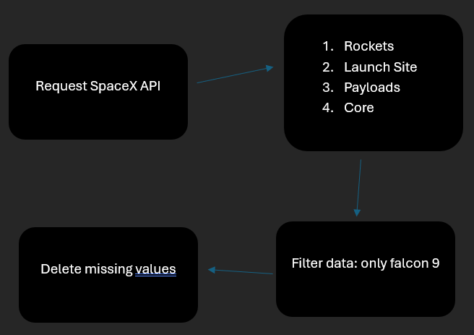
https://api.spacexdata.com/v4/payloads/
https://api.spacexdata.com/v4/payloads/
Data Collection – SpaceX API
https://github.com/ulisac04/final-project/blob/main/jupyter-labs-spacex-data-collection-api.ipynb
Rockets
Launch Site
Payload
Core

Slide 9
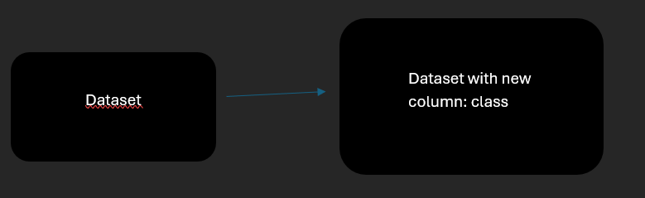
Data Wrangling
We were discussing what factors we could use to determine whether a launch was successful or not.
A new attribute was created: class; 1=successful launch, 0=failed launch
GitHub URL: https://github.com/ulisac04/final-project/blob/main/labs-jupyter-spacex-Data%20wrangling.ipynb

Slide 10
EDA with Data Visualization
Used graphics
Catplot to understand how the payload mass and the number of launches are distributed, with respect to the place of launch
Countplot to understand the ratio of successful launches PER rocket orbit.
Scatterplot to understand how the payload mass and the number of launches are distributed, with respect to the orbit
Lineplot to observe how the rate of successful launches evolved over time
GitHub URL https://github.com/ulisac04/final-project/blob/main/jupyter-labs-eda-dataviz.ipynb

Slide 11
EDA with SQL
Names of the launch sites
All launches that were made from sites starting with the string 'CCA’
The total payload mass sent from the "NASA (CRS)" station.
the average payload mass for Booster_Version = 'F9 v1.1’
date when the first succesful landing outcome in ground pad was acheived.
Names of the boosters which have succeeded in landing on a drone ship and have a payload mass between 4000 and 6000
Total count of successful and failure mission outcomes
Which booster_versions have transported the maximum recorded load?
GitHub URL https://github.com/ulisac04/final-project/blob/main/jupyter-labs-eda-sql-coursera_sqllite.ipynb

Slide 12
Build an Interactive Map with Folium
Map objects used: Markers, circles, lines
Markers: to indicate points such as launch sites
Circles: to indicate areas around specific coordinates.
Lines are used to indicate distances between two points
GitHub URL https://github.com/ulisac04/final-project/blob/main/lab_jupyter_launch_site_location.ipynb

Slide 13
Build a Dashboard with Plotly Dash
Use a standing chart to see the ratios of successful launch vs. failed launch. Explain why you added those plots and interactions
Use a plotted scatter graph to explain the relationship between uutcome and ayload mass peer booster version.
GitHub URL https://github.com/ulisac04/final-project/blob/main/dash_interactivity.py

Slide 14
Predictive Analysis (Classification)
Load the data and create a dataset.
Divided the training and test data
Tested the data with several classification methods and several hyperparameters.
GitHub URL https://github.com/ulisac04/final-project/blob/main/SpaceX_Machine_Learning_Prediction_Part_5.jupyterlite.ipynb

Slide 15
Results
Exploratory data analysis results
The average payload of F9 v1.1 booster almost 2.900kg.
Space X has 4 launch sites
Almost 100% of the missions were a success.
Interactive analytics demo in screenshots
launches are always carried out near a coast

Slide 16

Section 2

Slide 17
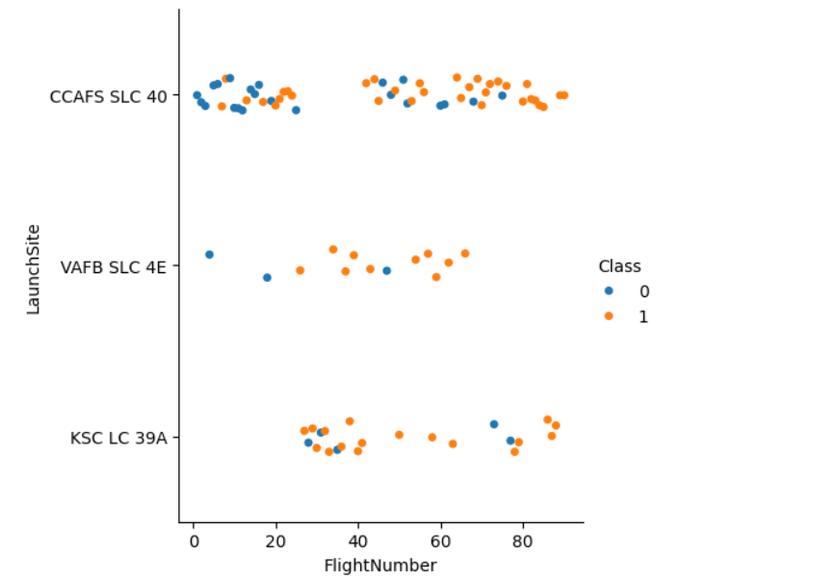
Flight Number vs. Launch Site
The more launches, the higher the success rate

Slide 18
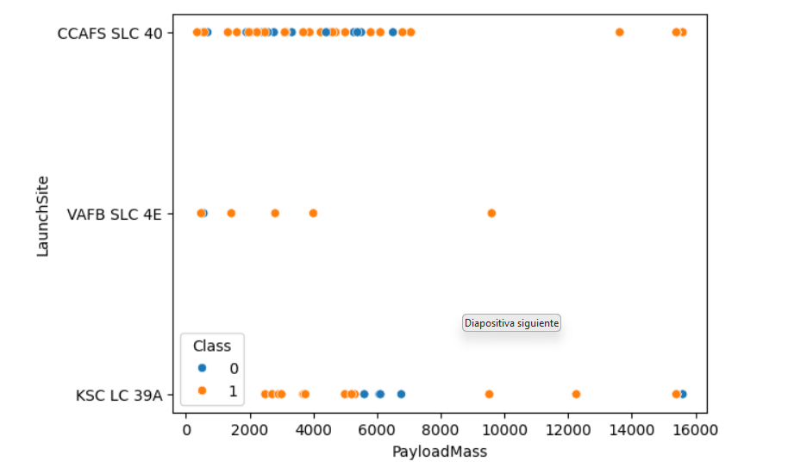
Payload vs. Launch Site
VAFB SLC 4E: has a 100% success rate

Slide 19
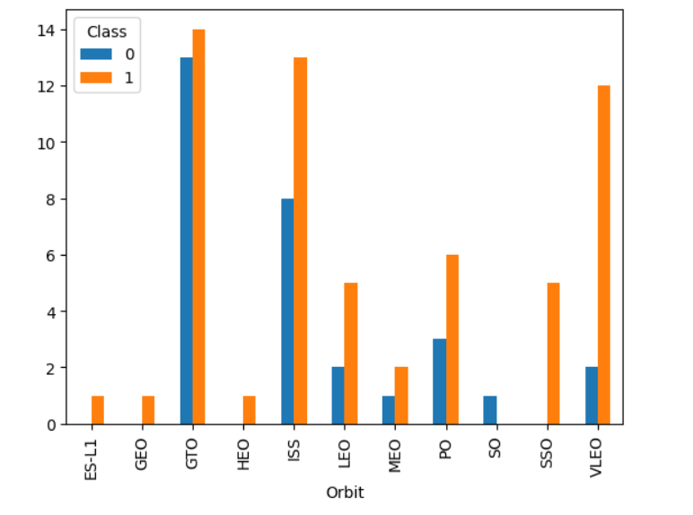
Success Rate vs. Orbit Type
SSO is 100% successful
GTO is the most deficient

Slide 20
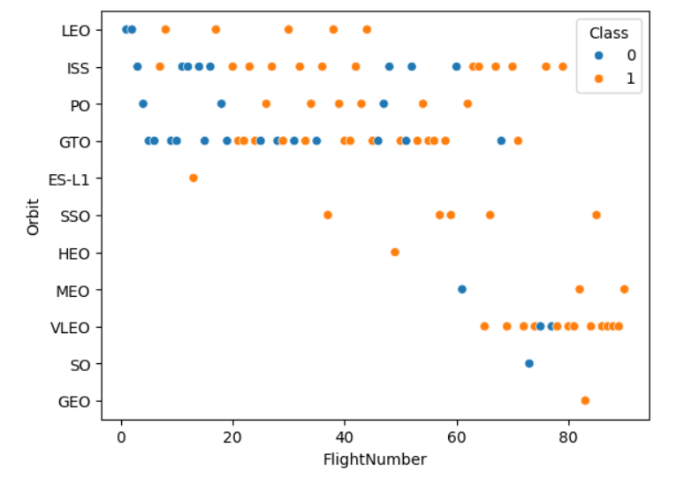
Flight Number vs. Orbit Type
SSO and HEO are the most successful
LEO is successful when there are more than 5 launches

Slide 21
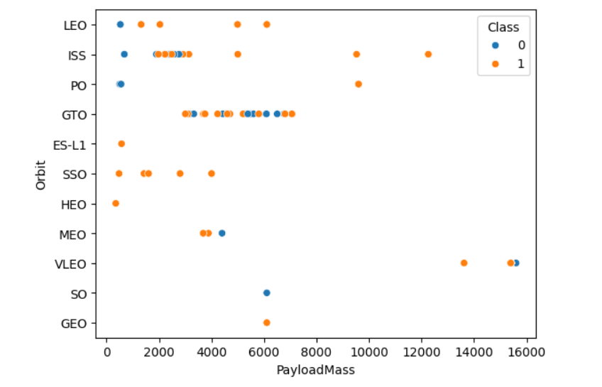
Payload vs. Orbit Type

Slide 22
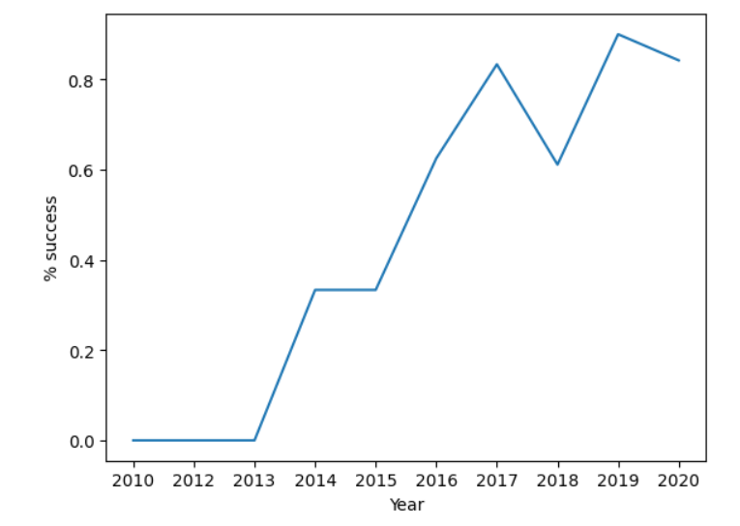
Launch Success Yearly Trend
The success rate has improved over the years.

Slide 23
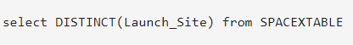
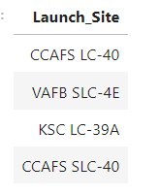
All Launch Site Names
Find the names of the unique launch sites
Present your query result with a short explanation here

Slide 24
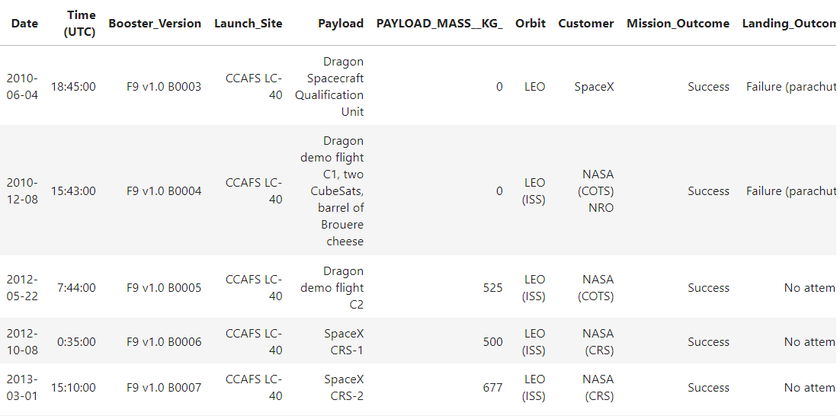
Launch Site Names Begin with 'CCA'
Find 5 records where launch sites begin with `CCA`
Present your query result with a short explanation here

Slide 25
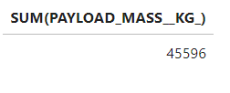
Total Payload Mass
Calculate the total payload carried by boosters from NASA
Present your query result with a short explanation here

Slide 26
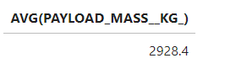
Average Payload Mass by F9 v1.1
Calculate the average payload mass carried by booster version F9 v1.1
Present your query result with a short explanation here

Slide 27
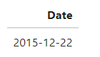
First Successful Ground Landing Date
Find the dates of the first successful landing outcome on ground pad
Present your query result with a short explanation here

Slide 28
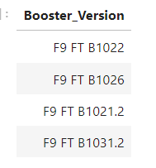
Successful Drone Ship Landing with Payload between 4000 and 6000
List the names of boosters which have successfully landed on drone ship and had payload mass greater than 4000 but less than 6000
Present your query result with a short explanation here

Slide 29
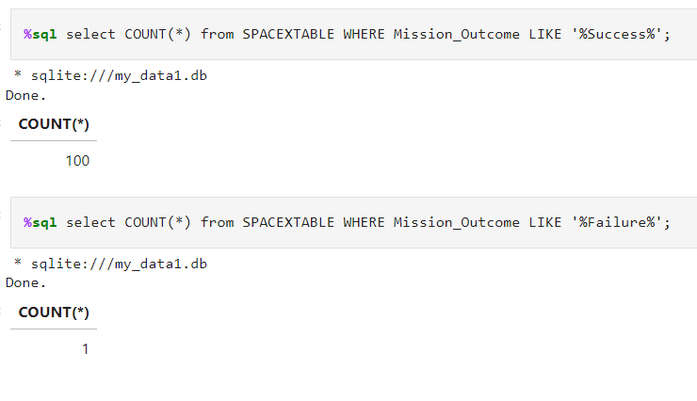
Total Number of Successful and Failure Mission Outcomes
Calculate the total number of successful and failure mission outcomes
Present your query result with a short explanation here

Slide 30
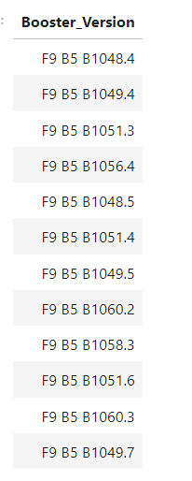
Boosters Carried Maximum Payload
List the names of the booster which have carried the maximum payload mass
Present your query result with a short explanation here

Slide 31
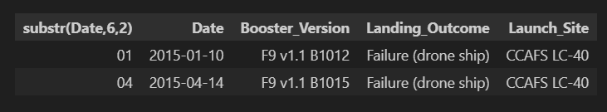
2015 Launch Records
List the failed landing_outcomes in drone ship, their booster versions, and launch site names for in year 2015
Present your query result with a short explanation here

Slide 32
Rank Landing Outcomes Between 2010-06-04 and 2017-03-20
Rank the count of landing outcomes (such as Failure (drone ship) or Success (ground pad)) between the date 2010-06-04 and 2017-03-20, in descending order
Present your query result with a short explanation here

Slide 33

Section 3

Slide 34
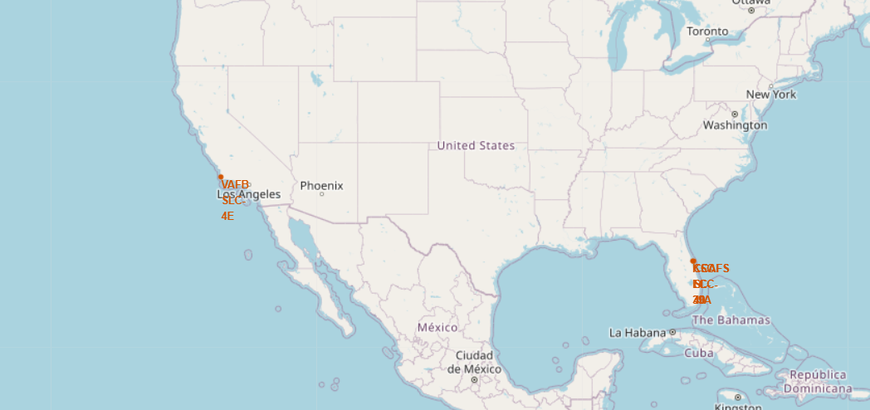
Launch sites

Slide 35
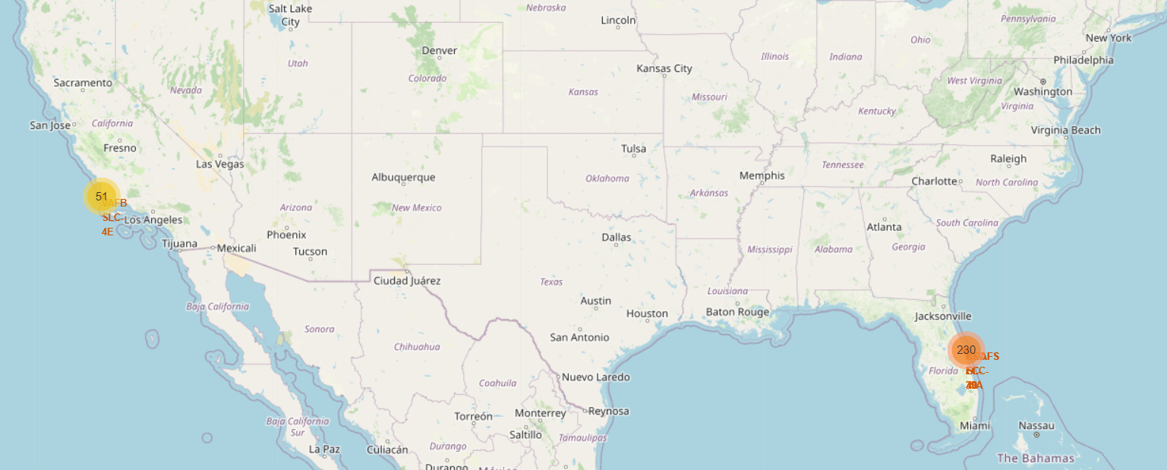
Number of launches, per site

Slide 36

Section 4

Slide 37
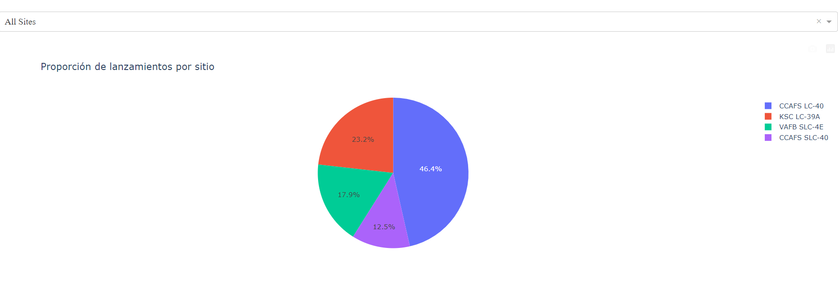
Successful launch rate at all sites

Slide 38
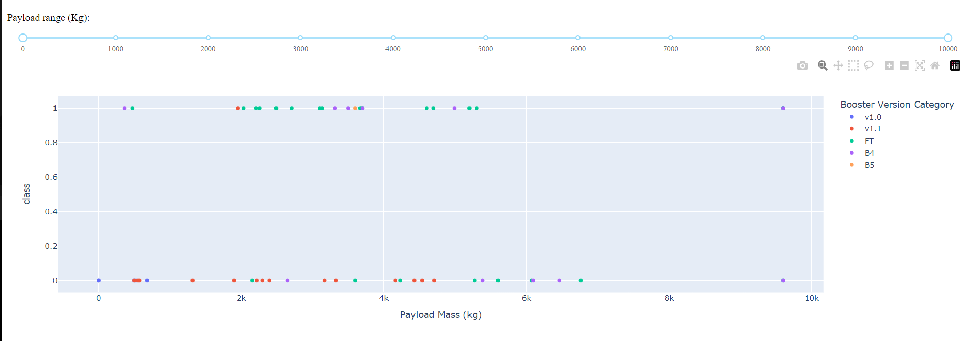
Relationship between payload mass and launch success segmented by booster type

Slide 39
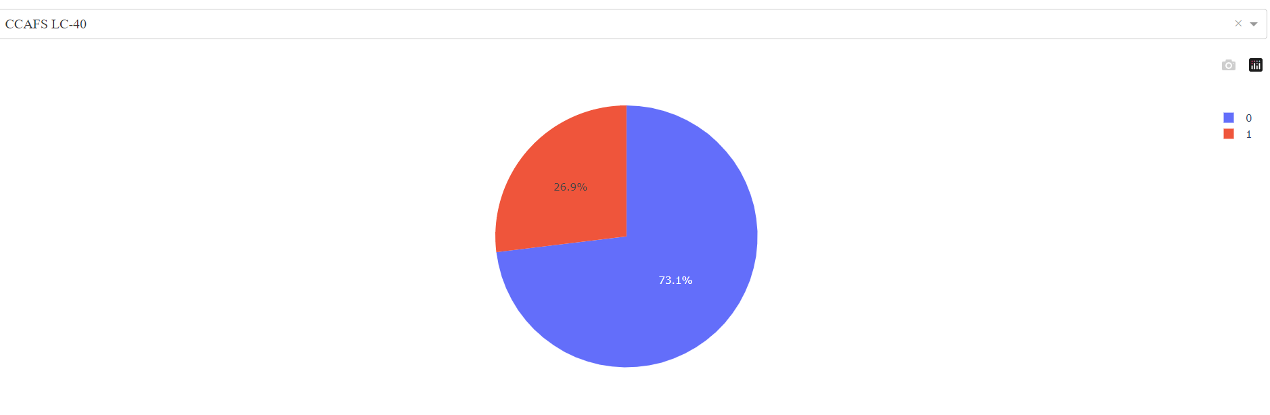
Successful launch rate in CCSFS LC-40

Slide 40

Section 5

Slide 41
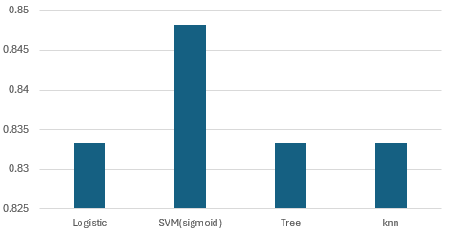
Classification Accuracy
All models have the same Accuracy. (SVM slightly a little more)

Slide 42
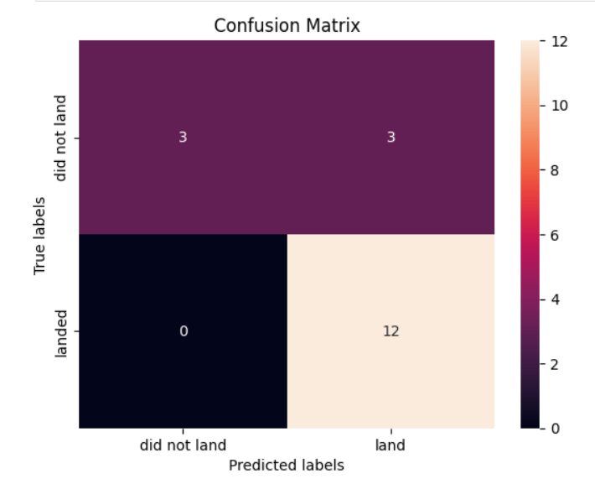
Confusion Matrix
Show the confusion matrix of the best performing model with an explanation

Slide 43
Conclusions
The best success rate in launches is positively related to the number of launches that occur on that site Point 2
Orbits ES-L1, GEO, HEO, SSO, VLEO had the most success rate.
The SVM model is the best machine learning algorithm for this task.

Slide 44


